Slide 1
Webpage Design and Development
Group three (3):
Rajheem Clarke, Johnross Bailey,
Shareon O’Brien, O’neil McKenzie
Dagrain Pettigrew

Slide 2
Insight
INTRODUCTION 3
BACKGROUND INFORMATION 4
RESEARCH 6
THE WHY? 8
LINKS 28

Slide 3
introduction
We are a group of young talented and ambitious students, who are taking the step to delve into the world of Software Programming.
We are proud to present to you the work that we have done

Slide 4
Background Information

Slide 5
Ministry of finance
Collaboratively, the group decided to redesign the Ministry of Finance website. For a government site the use of word press and their selected color scheme seem childish. By recreating the website, we wish to rebrand Jamaica as a developing country with great potential, that would one day be a choice of place to live, work, raise families and do business.

Slide 6
Review of websites
Eye-catching color scheme, great use of space, site was not overwhelming and easy to navigate
Japan
Simplicity usage of color palette, showcased less is more, feel of website was authoritative
Canada
Not content focused, easy to navigate, simple design
Home page had multiple links to news and lacked anything directly relating to the finance of the country, too crowded, not easy to navigate
Thailand
Barbados
Simple design, purpose of website was explained, introduction of ministers’ responsible for sector, easy to navigate
USA

Slide 7
Properties adopted
navigation
Ensure website is easy to be read and utilized by everyone
Simplicity
Make website feel free by concising information
Color scheme
Have colors that complement each other and set a respective mood
Clarity
Ensure viewers know what the website is about
publication
Adding ‘news’ article and documents portray responsibility to citizens that the government is working

Slide 8
Why redesign?
Website looks outdated
The use of full blue on the website makes it look outdated
The latest web designs are flat dimensional and use simple patterns
With a website that is up-to-date the government will give the assurance that they are growing to the public
Re-branding
Based on other sites they have their countries flag in the page header along with the title having the countries name in it

Slide 9
Why redesign? Cont’d
Generic look
Based on the framework of the current website its structure implies that site was made using WordPress. As a government website we believe that it should be original
We want the website to appear professional rather than generic
Content focused
The government site has a lot of information, and some are duplicated. With the redesign the site will be more content focused.

Slide 10
Why redesign? Cont’d
Color scheme
Blue and yellow are the main colors on the government’s website which were taken from the MOFPS icon. Usage of more subtle colors will aid the site in its financial purpose

Slide 11
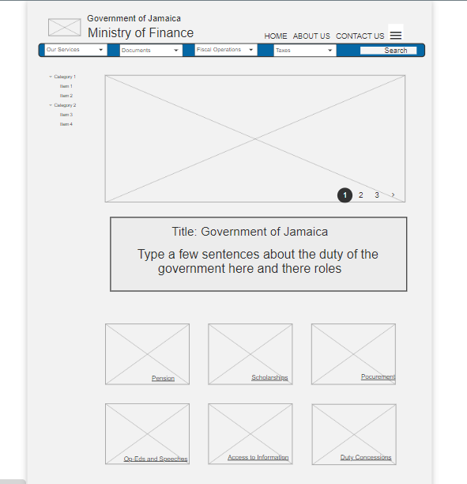
Prototype 1
The heading contains an image for the flag of Jamaica and respective titles.
The nav-bar in the header has 3 buttons and a hamburger menu.
The nav-bar has 4 drop-down menus and a search option.
To the left is another drop-down menu for users to utilize

Slide 12
Prototype 1 cont’d
image
paragraph
images
The image chosen is a carousel with the option to choose the image being viewed
Below the carousel is a paragraph entailing a title and sentences to describe the webpage.
After the paragraph is a flex-grid of opportunities and information that is offered to the public, which originates for the webpage

Slide 13
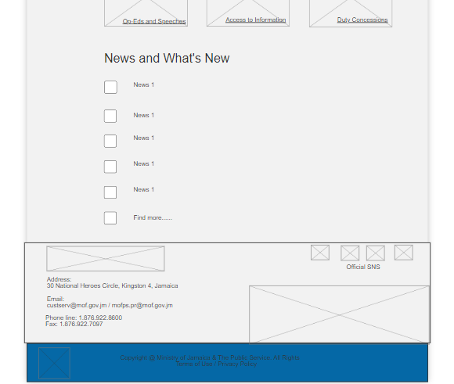
News and What’s New section contains articles about the Government and projects that they are involved in.
The ‘ending’ is the section above the footer. The section holds the Governments’ address, email and phone number, social media links and images that are distinctive to Jamaica.
The footer simply holds copyright information, terms of use and Privacy Policy.

Slide 14
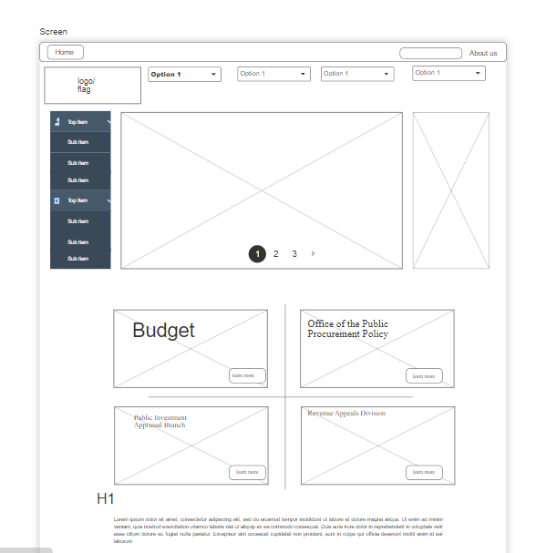
Prototype 2
The header on prototype 2 has a nav-bar of ‘Home’, ‘Search’ and ‘About us’
Right below is another nav-bar that has the image of the Jamaican flag and 4 drop-down menus
A side menu bar is located to the left of a carousel image and another image

Slide 15
Prototype 2 cont’d
images
Paragraph
A 4-image flex-grid with title is shown.
The ‘learn more’ button is hyperlinked to go to each respective page.
A paragraph is right below to describe what the site is about and what can be found on it.

Slide 16
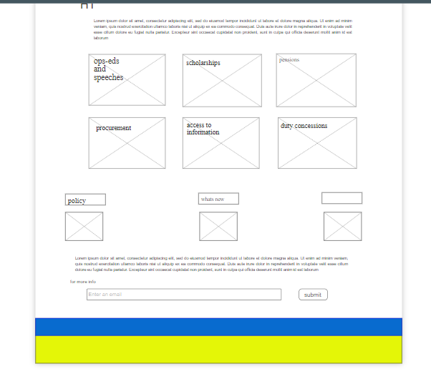
Prototype 2 cont’d
After the paragraph six more images in a flex-grid is used. The title of each is a hyperlink to each respective page
Images with titles above are used to reduce page clutter. Each is hyperlinked
Another paragraph is then used to give further information on the webpage and a subscription to the Governments’ newsletter is imployed

Slide 17
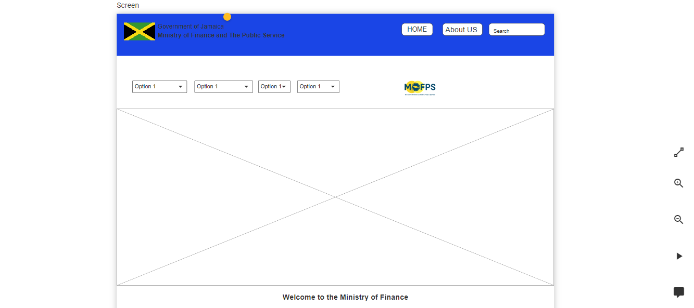
The Chosen Prototype

Slide 18
The Parts
Header
Second nav-bar
Image
Includes the Jamaican Flag and “Government of Jamaica”
The usage of 3 buttons as the navigation which includes a search icon for the simplicity of searching for exactly what you want
Use of space ensures readability
Contains the drop-down menu for easy access
The MOFPS icon was added to this design to have a touch of its originality and the sites identifier
In keeping with the latest design trends an image after the nav-bar was included
This was to attract the user's attention and guide their eyes

Slide 19
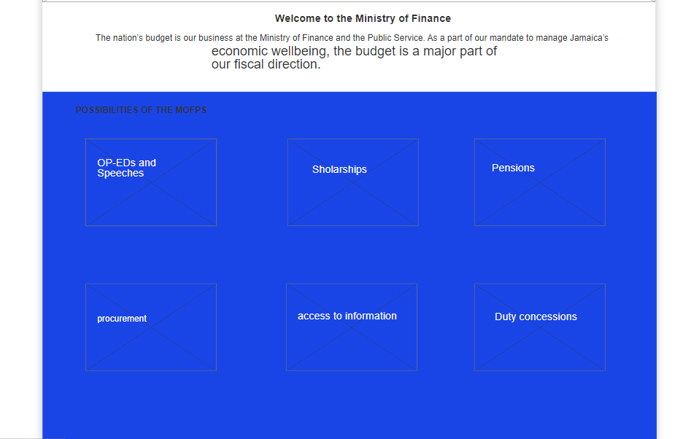
Section two of Prototype

Slide 20
The Parts cont’d
Heading tag
Welcome message
Images
The title “Welcome to the Ministry of Finance”
The heading tag reaffirms the purpose of the page
It is also used as a means of welcoming visitors to the site
The simple message states what is expected to be found on the website and the websites purpose
The same flex-grid layout of images was used for its simplicity and easy navigation.
This image orientation displays opportunities and topics offered by the government

Slide 21
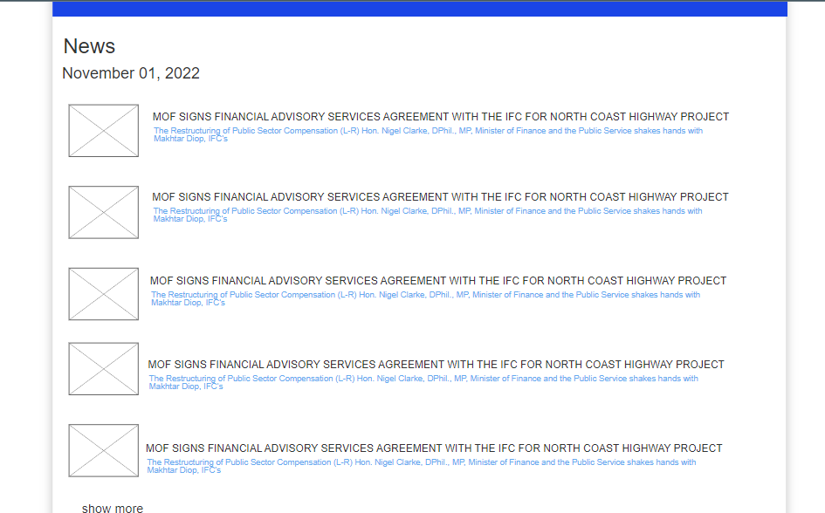
Section 3 of Prototype

Slide 22
The Parts cont’d
Heading tag
Date
Events
The title “News”
Gives users an idea of what the section is about
The date is a hyperlink to an event that will be hosted on that date
The events are displayed with a small image on the left and the event title and description on the right of the image
The description of the events are hyperlinked to the article site

Slide 23
The Parts cont’d
Show more
Simplicity
A link to a page with past and present articles
Gives users an option of searching for older releases
One the current website the news section is created to mimic a slideshow. With this new design its simpler and easier to navigate

Slide 24
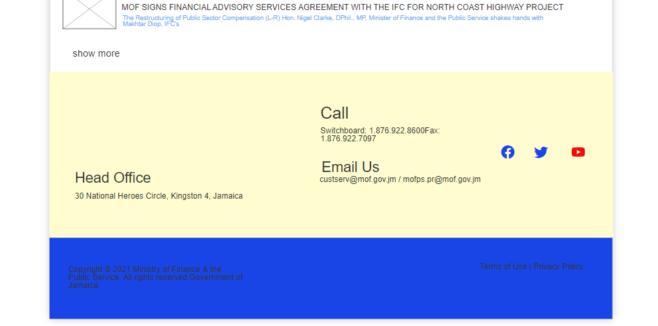
Section 4 of Protoype

Slide 25
The Parts cont’d
Ending
footer
Above the footer is the ‘ending’ of the webpage. Within this section is the location, phone number and email address of the Ministry
This section also holds the hyperlinked social media icons that the Government can be found
We thought it best to keep the footer free of clutter.
The only thing found in the footer is the Terms & Privacy Policy along with copyright info

Slide 26
Why we made the choice we did?
The final wireframe
Color scheme
Color scheme
The chosen prototype features easy navigation, efficient use of space, and content focused.
The wireframe has features from researched site that gives the wireframe an edge above the others.
The light blue represents friendliness and is refreshing
Black represents power and formality
Teal means revitalization, open communication and clarity. Its effects are calming and gives a sense of authority.
Beige represents dependability, relaxation and calmness.
This color scheme was chosen from color hunt as we not only wanted to redesign the Governments’ website but to also instill a sense of calmness in users while maintaining the power that the Governments has

Slide 27
Why we made the choice we did?
Font/typeface
Font/typeface
Images and videos
The Roboto font was chosen for its versatility.
The Roboto allows letters to take up as much space as it needs and ultimately, makes for an improved experience for the reader.
Roboto is also designed for a wide range of devices, sizes and resolution.
It is of most importance for the Governments’ website to be easily read and for any device the user is using readability is present.
The same images and videos were used form the original webpage. When searching for images and videos for replacement the stock images were not in correlation with the Jamaican Government.
The images found were forced and we wanted to represent the country of Jamaica.

Slide 28
Links
netifly
https://mof-gov-jm.netlify.app/
Github
https://github.com/GitMaica/group-redesign
Quant-ux 1
https://quant-ux.com/#/share.html?h=a2aa10aVLDzRHvm097kLWTKfcrs5e4Vcz3ZhTp1phfvPRa79BucRz5reJubC
Quant-ux 2
https://www.quant-ux.com/#/apps/630d6030280efd5a08c28d53/design/s10000_39729.html
Quant-ux 3
https://www.quant-ux.com/#/share.html?h=a2aa10an003VjUUvTJosNtkUlZuIyEhA3ueYjGFb1saiolODl0wcvk7Lp7T2

Slide 29
Links
usa
https://home.treasury.gov/
Japan
https://www.mof.go.jp/english/index.htm
Thailand
http://www2.mof.go.th/
Canada
https://www.canada.ca/en/department-finance.html
Barbados
https://www.gov.bb/Ministries/finance-economic-affairs

Slide 30
Links cont’d
Color Hunt
https://colorhunt.co/palette/2c3333395b642666cff5f2e7

Slide 31
thank you

